Slide 1
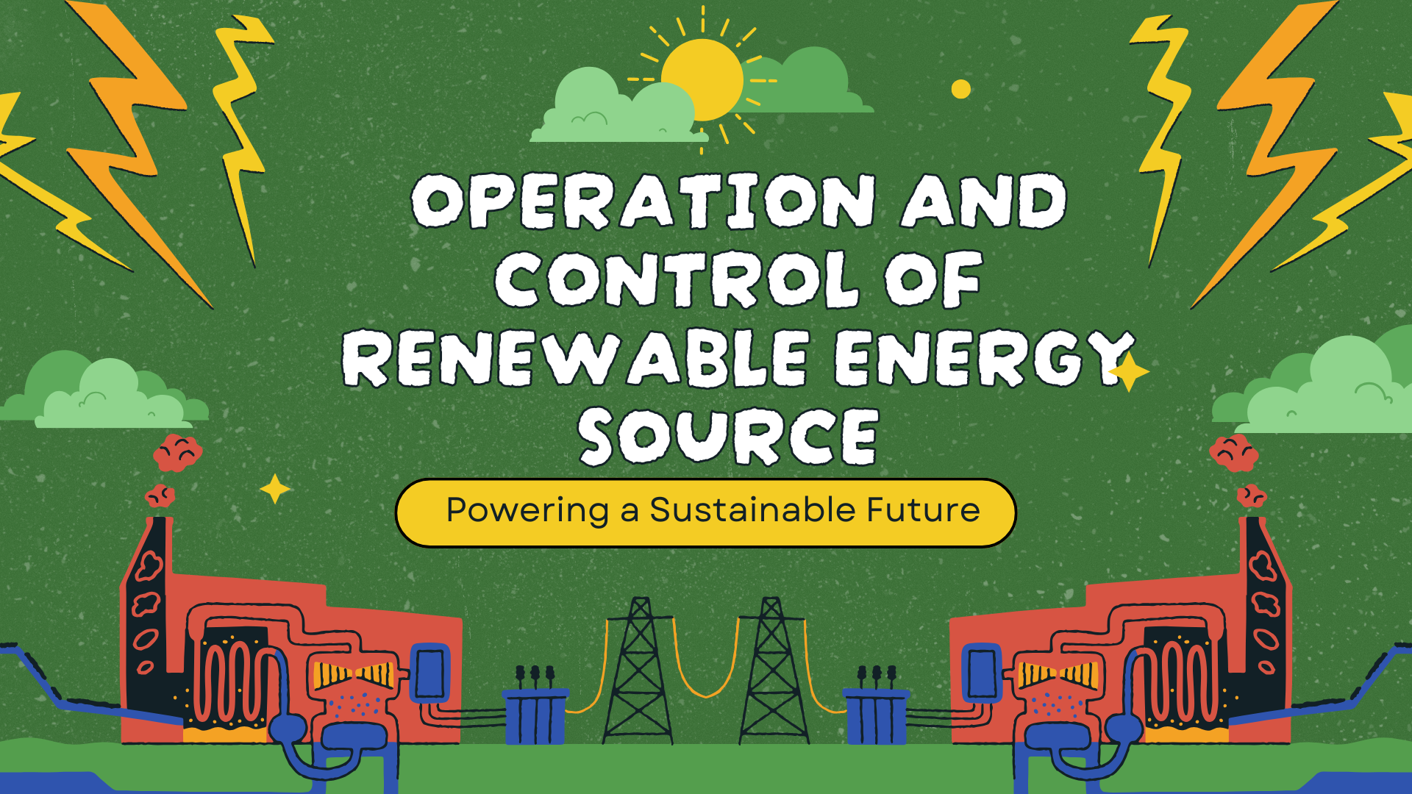


Slide 2


TEAM NAME : TERRAMINDS
TEAM MEMBErS :
ANKIT KUMAR
SHREEDHAR ANAND
RAMA ASHISH YADAV
ARYAN JHA
MADHAV

Slide 3
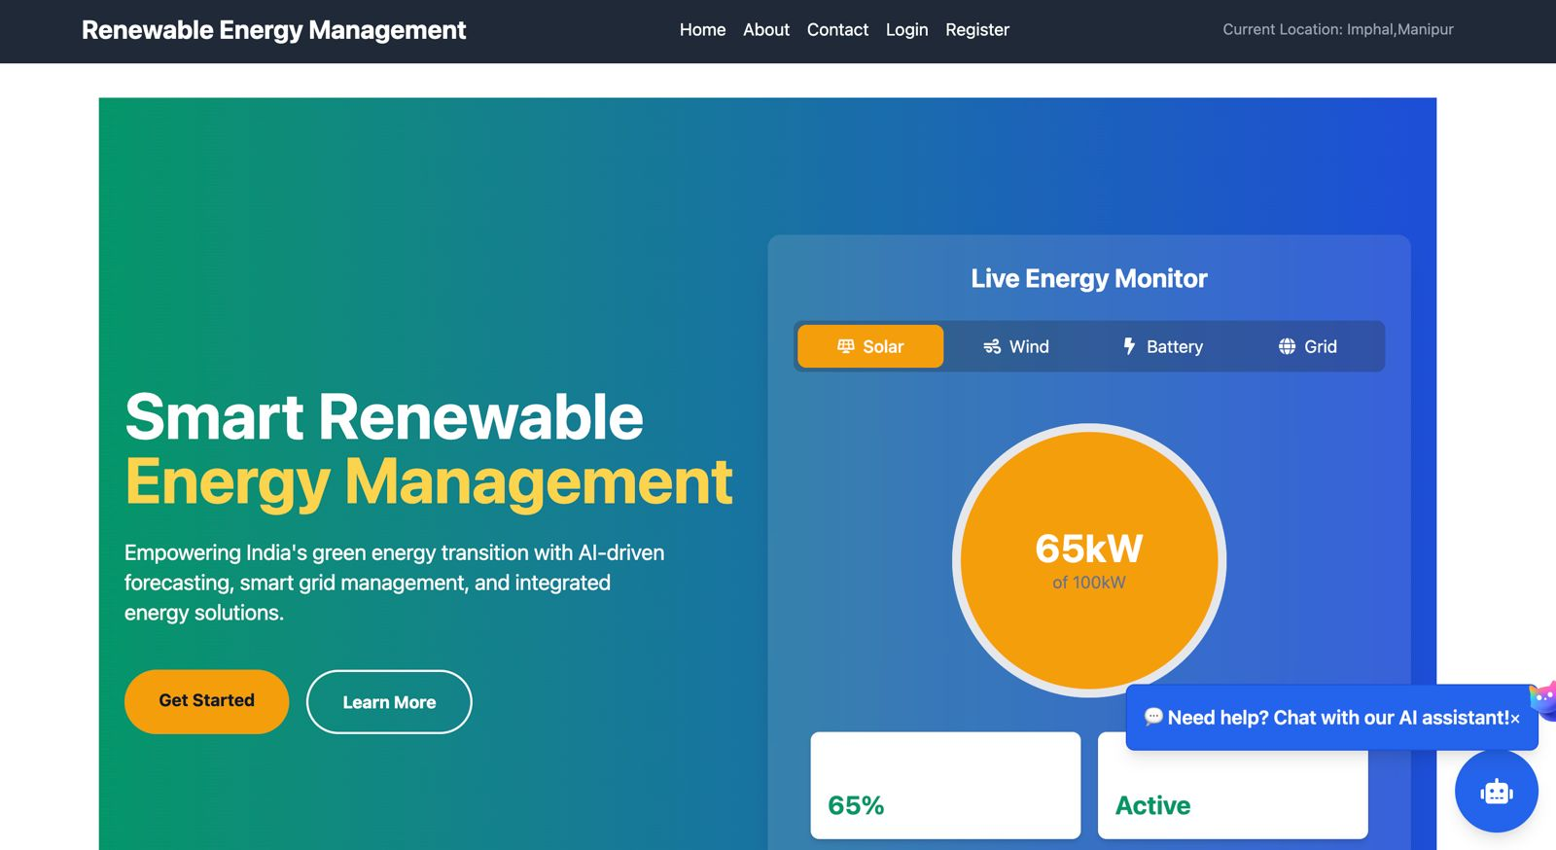



Problem statement :
The variability of solar and wind energy causes grid instability, inefficient storage, high maintenance costs, and challenges in energy trading, impacting the reliability and sustainability of renewable energy systems.
Proposed solution :
Smart renewable energy management
An AI-powered platform for efficient grid management, leveraging IoT to collect real-time data for accurate solar and wind energy prediction. Additionally, our AI-driven maintenance system enhances the reliability and sustainability of renewable energy infrastructure.
Major Tech used
-> Ai Model : Prediction with Optimized backend
-> IoT : Fetching real time data
-> ChatBot : For Energy Management Related Query

Slide 4

Global Losses Due to Lack of Renewable Energy Management & Grid Monitoring
1. 1,000 TWh of renewable energy wasted annually due to poor grid integration..
2. Battery degradation accelerates by 30-40% without optimized charging cycles.
3. Unplanned power plant failures cost $10 billion+ per year in operational losses.
4. Empowering Rural & Remote Communities.

Slide 5
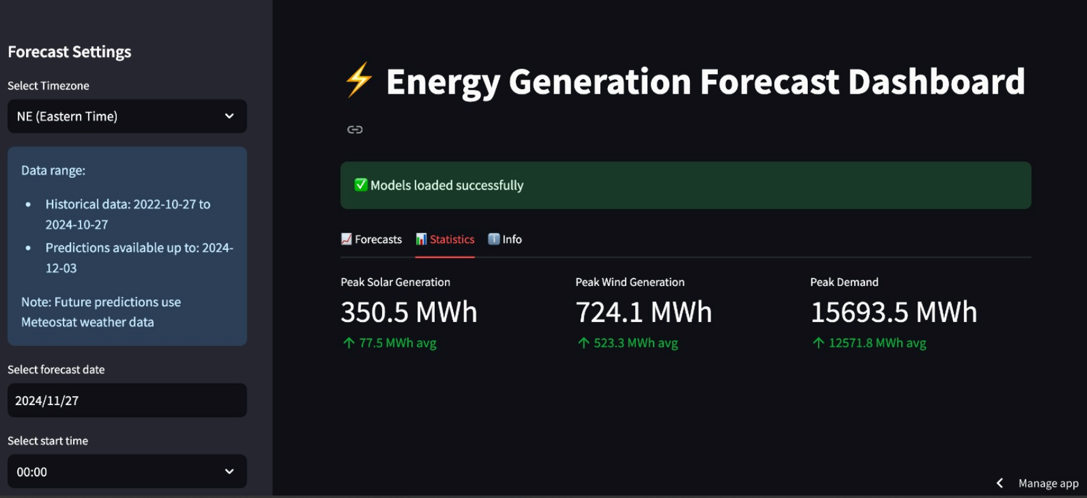
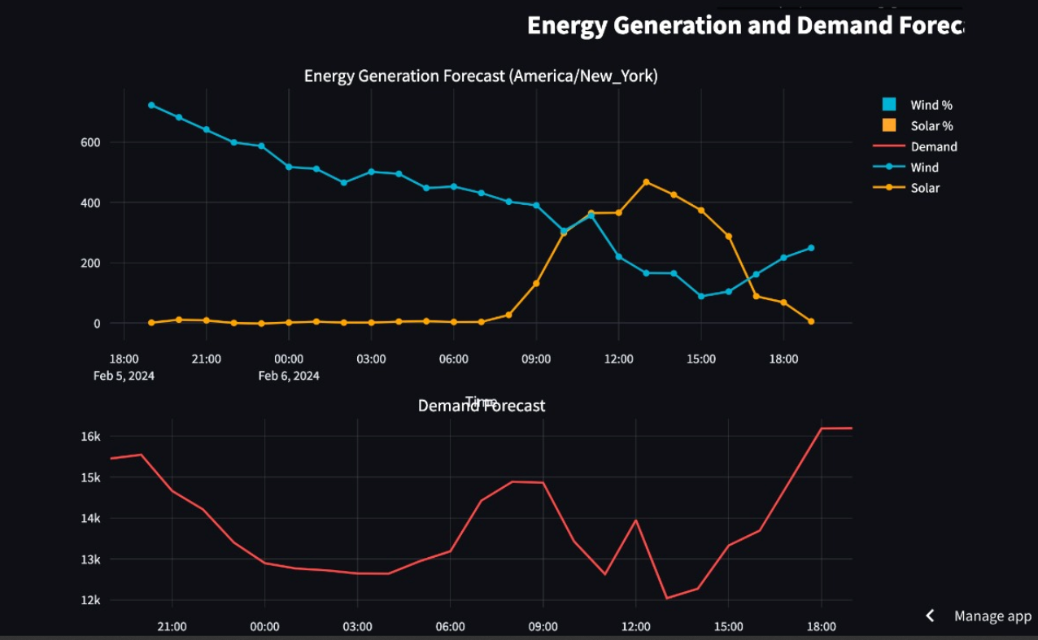
Major Problems addressed by our solution :
Energy Production Forecasting Uncertainty Problem:
Solar and wind power generation are highly weather-dependent and fluctuate due to changing conditions like cloud cover, wind speed, and seasonal variations.
This variability makes it difficult for grid operators to plan power distribution efficiently.
How our project resolves this issue :
->Model predicts energy generation based on historical data, weather forecasts, and sensor data from solar/wind farms.
-> More accurate forecasting helps grid operators balance supply and demand in real-time.

Slide 6
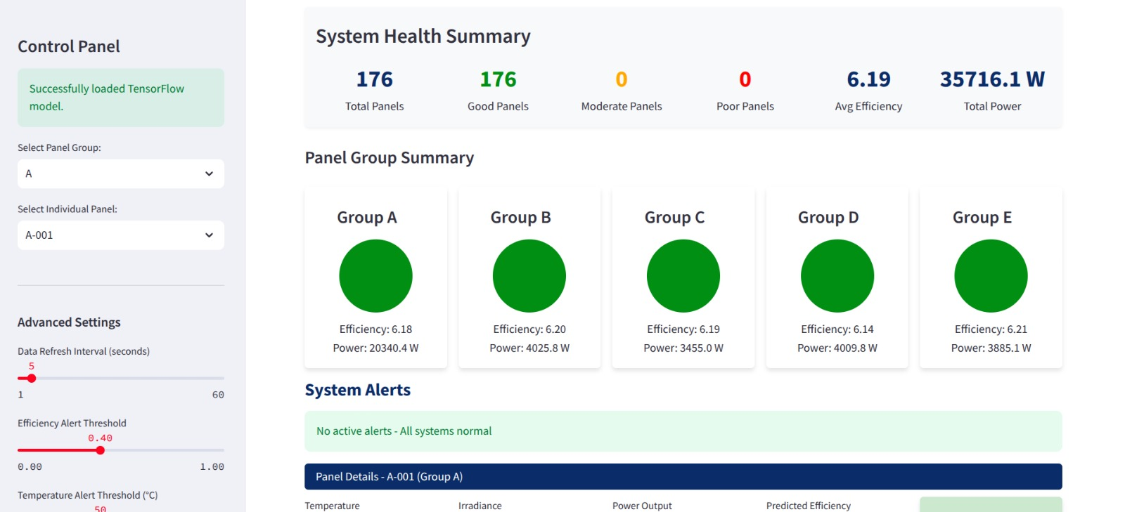
2. Predictive Maintenance & Fault Detection :
Wind turbines, solar panels, and grid infrastructure wear out over time due to environmental stress leads to unexpected breakdowns, costly repairs, and downtime.
How our project resolves this issue :
->AI can analyze sensor data (temperature, vibration, power output) to detect early signs of equipment failure.
3. Grid stability and energy management :
Renewable energy sources are intermittent, meaning they do not produce a steady flow of power.This variability makes it difficult for grid operators to plan power distribution efficiently.
How our project resolves this issue :
->Our Model provides real-time insights into energy production, allowing grid operators to integrate storage solutions (e.g., batteries) and backup sources more effectively.

Slide 7
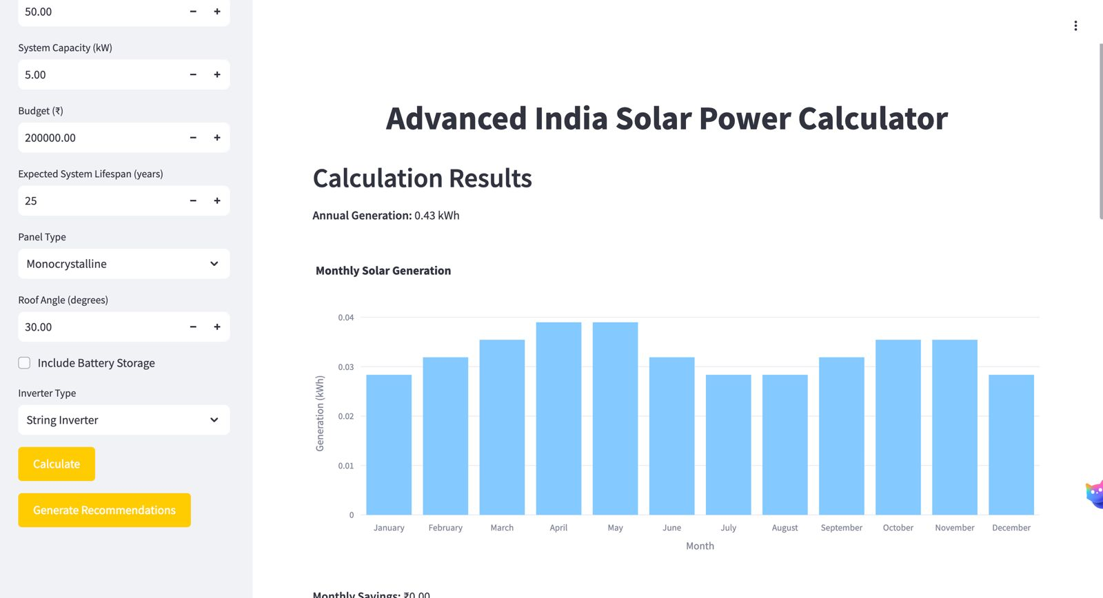
4. ENERGY TRADING AND MARKET OPTIMIZATION :
Renewable energy producers often sell surplus power to the grid, but energy prices fluctuate based on supply and demand..
How our project resolves this issue :
->Models forecast future energy production and market demand, helping producers sell at the right time for maximum profit.
Unoptimized use of energy by general public:
Ai Model will give people suggestion on optimized use of source for better Economic management.

Slide 8
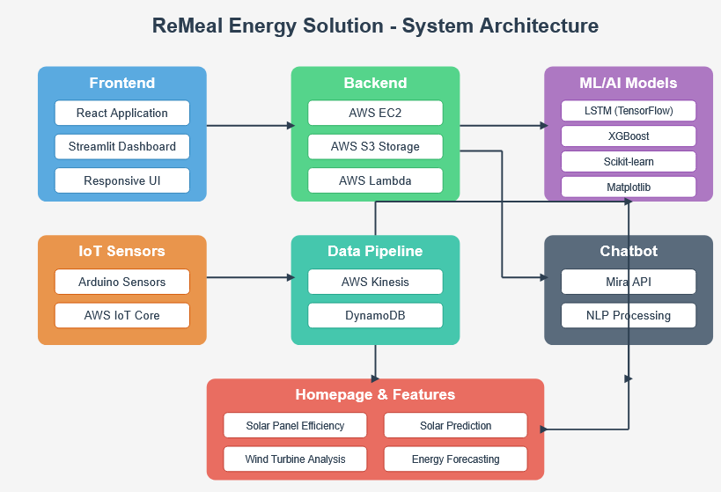
FLOW diagram of our project :

Slide 9
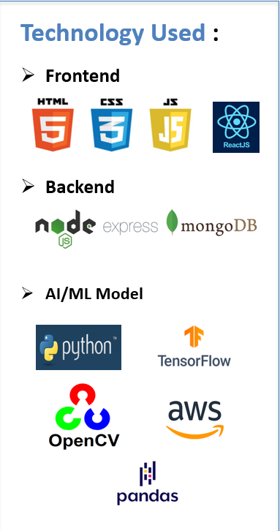
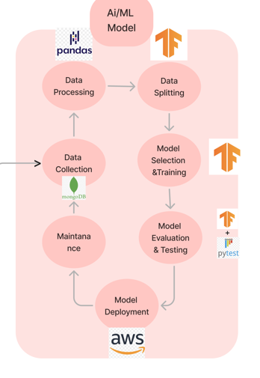
AI model diagram :

Slide 10

Impact on society :
1. Increased Renewable Energy Adoption.
2. Cost Savings for Consumers & Industries.
3. Reduction in Carbon Emissions & Climate Impact.
4. Empowering Rural & Remote Communities.
5. Strengthening Energy Security & Independence

Slide 11

Future Aspects of our project :
1. Government Policy & Renewable Energy Planning Support.
2 Expansion to Other Renewable Energy Sources
3. Decentralized Energy Trading Using Blockchain.

Slide 12

THANK YOU

